Slide 1
TWA, HRT의 임상적 의의
연세원주의과대학 심장내과
박영준

Slide 2
Background

Slide 3
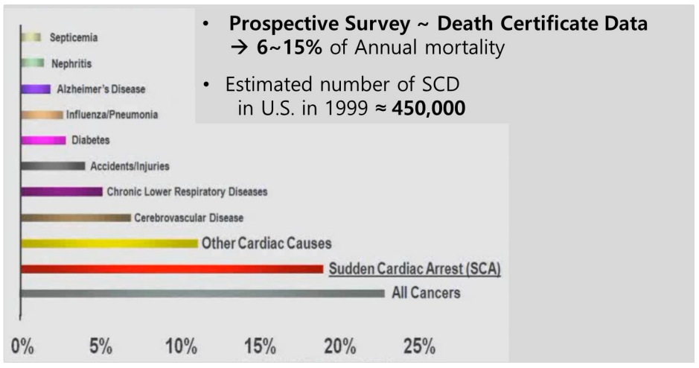
SCD is a leading cause of death
National Vital Statistics Report. 2001;49:11
MMWR Morb Mortal Wkly Rep. 2002;51(6):123

Slide 4
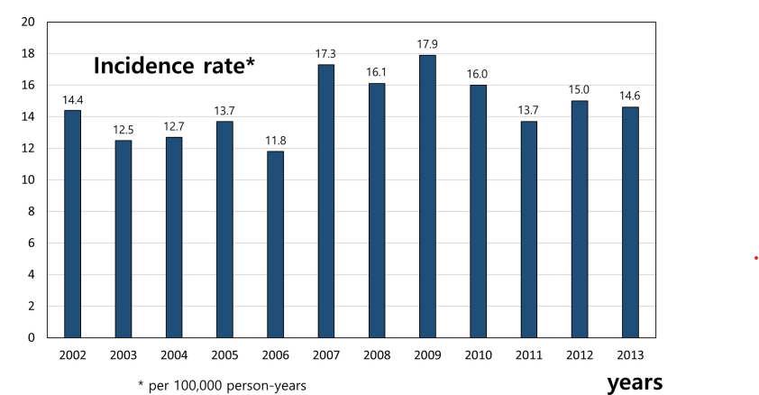
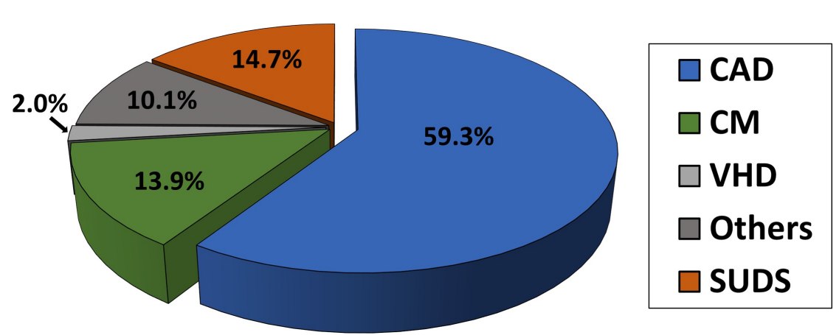
Sudden cardiac death in Korea
The incidence of primary SCA was 16.1 per 100,000 person-years
CAD was the most common cause of SCA (59.3%)
Sudden unexplained death syndrome accounted for 14.7% of SCA.
PLoS One. 2020 Nov 25;15(11):e0242799

Slide 5
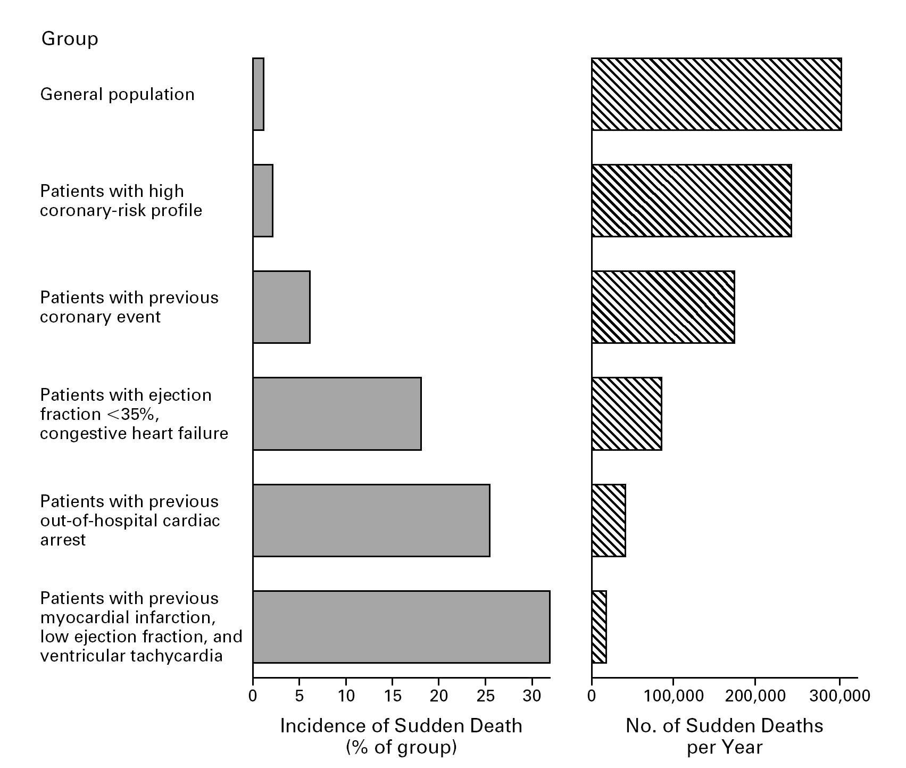
SCD Incidence & Prevalence
Myerburg, et al. Circ 1998;97:1514-1521

Slide 6
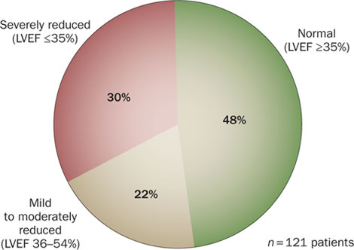
Ejection fraction(EF) is not a good predictor of SCD
findings from the Oregon Sudden Unexpected Death Study
(LVEF≥55%)
Nature Reviews Cardiology 7, 318-326 (2010)

Slide 7
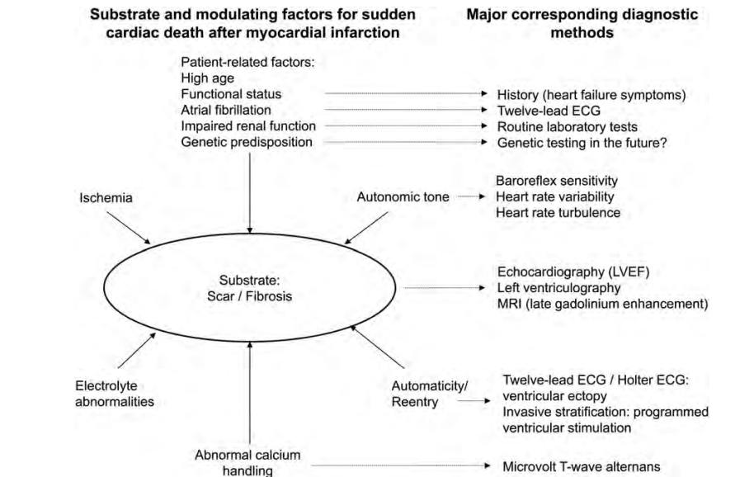
Eur Heart J. 2013 Jul;34(26):1964-71

Slide 8
T wave alternans?

Slide 9
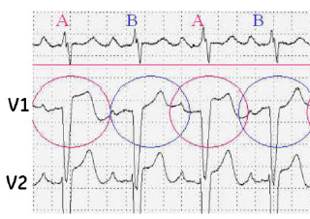
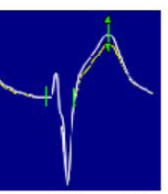
T-Wave Alternans(TWA)?
Beat-to-beat variability in the timing, shape, and/or amplitude of T-waves on the surface ECG

Slide 10
Why is TWA is important?
Indicator of cardiac electrical instability
Indicator of vulnerability of VT/VF
Used for SCD risk stratification

Slide 11
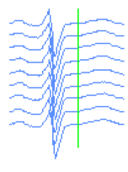
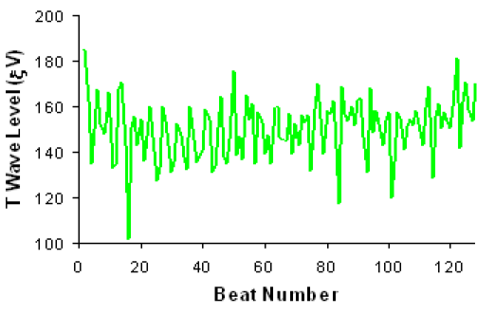
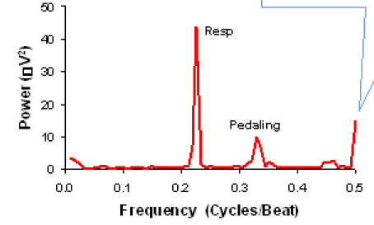
The Spectral Method
Target HR 105-110 beats using specialized exercise protocol, pharmacological agents or atrial pacing.
Fast fourirer transform(FFT) technique to beat- to beat series of amplitude measurements along the 128 consecutive QRS ECG complexes.
ECG (128 beats)
Fast Fourier Transformation (FFT)
TWA
Time series
Spectrum

Slide 12
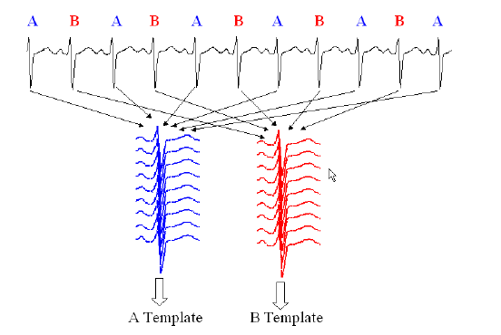
Modified Moving Average (MMA) Method
Continuously streams odd and even beats into separate bins and creates median complexes.
These complexes are then superimposed, and the maximum difference between the odd and even median complexes at any point within the JT segment
A template
Average
B template
Average
cv
cv
A template
Average
B template
Average
(average)

Slide 13
Clinical implication of TWA?

Slide 14
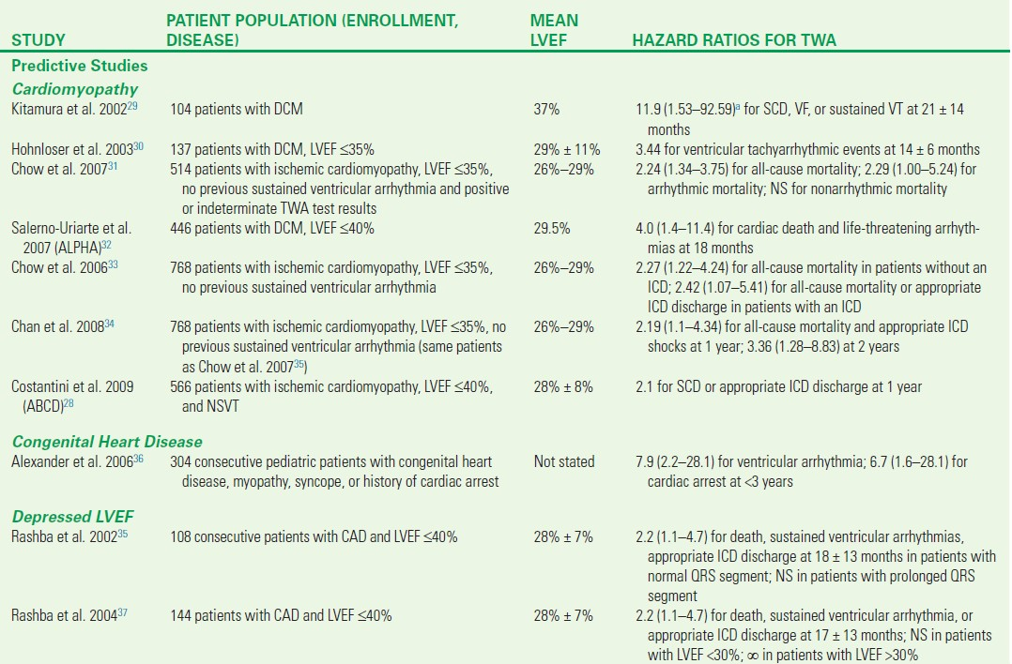

Slide 15
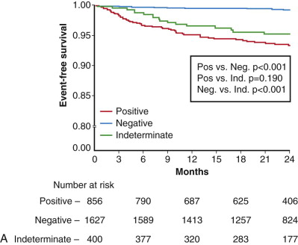
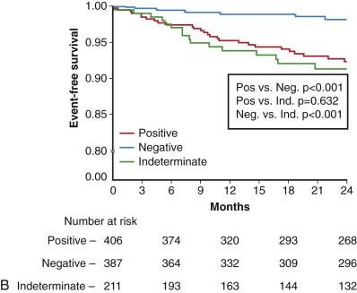
Risk stratification of patients with ICMP
2883 patients without history of previous ventricular tachyarrhythmias
Arrhythmic mortality/sudden death
Patients with an LVEF ≤0.35
J Am Coll Cardiol.2006;47:1820–1827

Slide 16
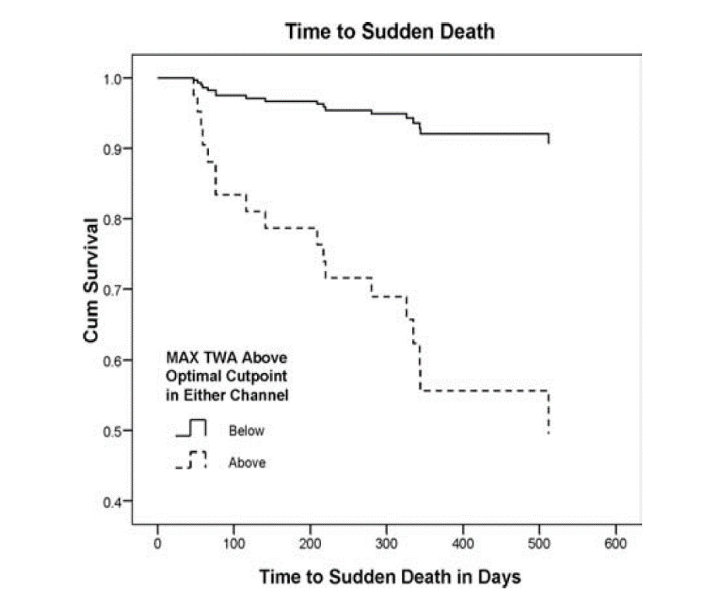
Elevated TWA predict SCD in MI patients
493 patients
Post-MI day 2~10
TWA (Ambulatory ECG-based)
500 days f/u
< 43μV (V₁) and < 47μV (V₃)
RR 5.2(CI, 1.8-14.6 p=0.002)
≥ 43μV (V₁) or ≥ 47μV (V₃)
J Cardiovasc Electrophysiol, 2008; 19: 1037-1042

Slide 17
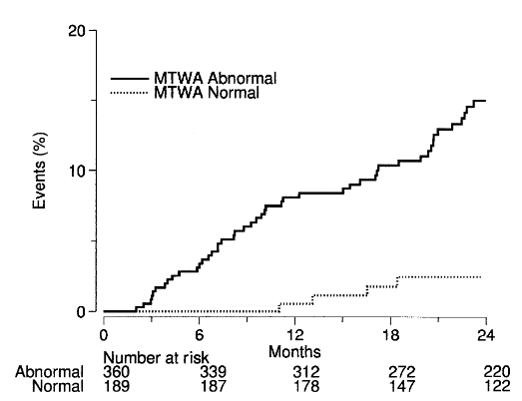
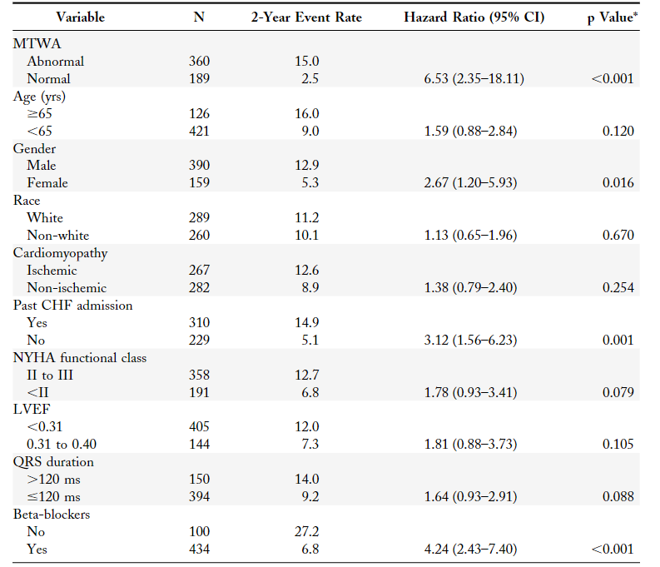
TWA in patients with patients with HFrEF
549 patients with EF ≤ 40%
Age 56±10%
Mean EF 25 ±6%
2 years f/u
Death and ventricular arrhythmia
15%
2.5%
J Am Coll Cardiol. 2006;47:456–463.

Slide 18
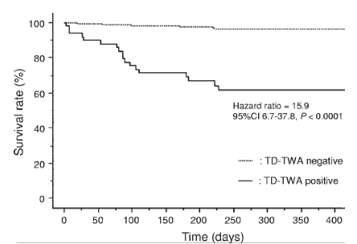
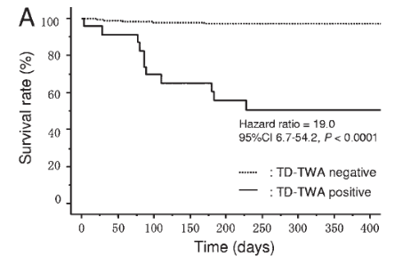
Elevated TWA predict SCD in HFrEF patients
195 patients(100 ICM, 95 NICM)
EF < 40%
Age 66±16%
Mean EF 35 ±6%
Cut off value 65 µV
All patients
NICM patients
Heart Rhythm. 2009 Mar;6(3):332-7

Slide 19
Heart rate turbulence?

Slide 20
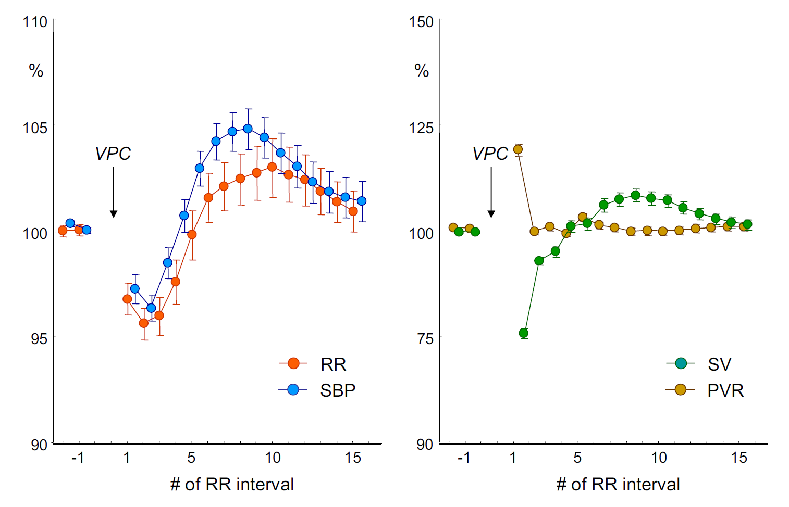
Heart rate turbulence(HRT)
Indirect assessment of Cardiac Autonomic Function
Short-term fluctuations in sinus RR interval after VPC

Slide 21
Turbulence onset(TO), Turbulence slope(TS)
The values of TO > 0% and TS < 2.5 ms/RR interval were defined abnormal, respectively

Slide 22
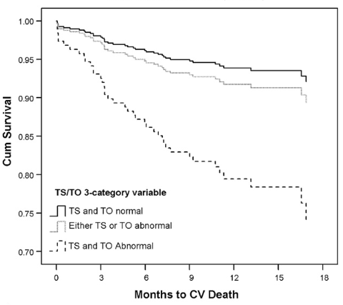
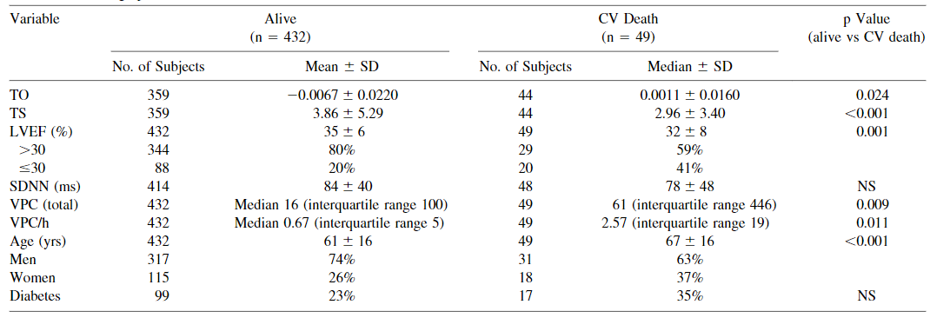
HRT predict CV death in patients with AMI
481 patients with AMI
2~10days after AMI.
18 months f/u
Cutoff : TS ≤3.0ms/RR, TO ≥ 0
RR 4.8/4.72
Am J Cardiol. 2009 Jun1;103(11):1495-9

Slide 23
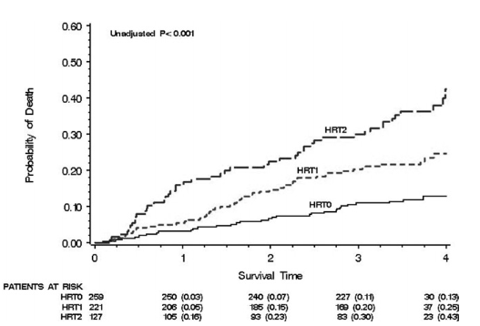
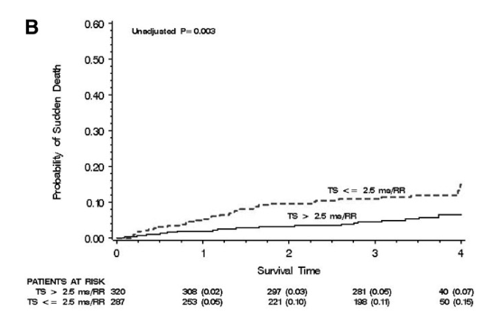
HRT predict death in patients with HF
507 patients with HF
Age 63±12%
Mean EF 37 ±14%
3 years f/u
All cause death
Sudden cardiac death
Heart Rhythm. 2008 Aug;5(8):1095-1102

Slide 24
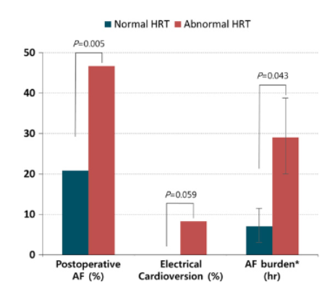
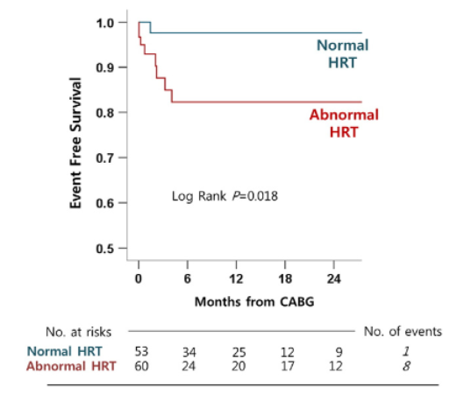
HRT predict new-onset AF
172 patients
HRT measurement prior to CABG
Without AF
Int J Cardiol. 2014 Jul 1;174(3):579-85

Slide 25
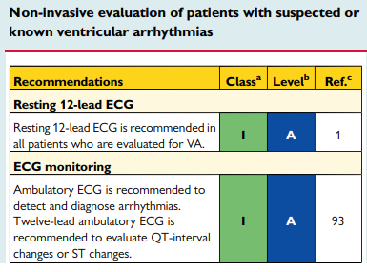
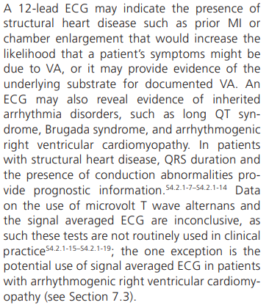
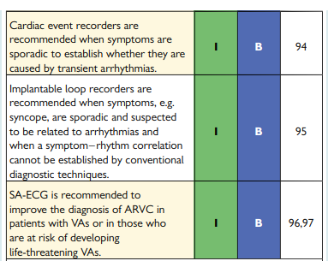
Current guidelines
2015 ESC guideline
2017 AHA guideline

Slide 26
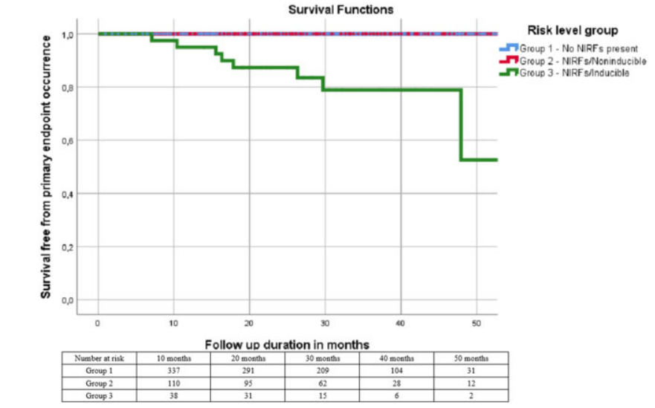
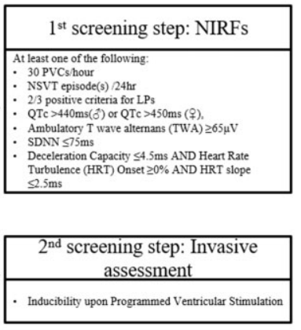
Arrhythmic risk stratification
Post MI with preserved EF (n=575)
Eur Heart J. 2019 Sep 14;40(35):2940-2949

Slide 27
Summary
TWA is an indicator of cardiac electrical instability, can predict SCD in patients with HF, ischemic heart disease.
HRT s an indicator of cardiac autonomic function, can predict SCD, all cause death, new-onset AF.
Combined non-invasive risk stratification approach can be effectively addressed SCD.

